Slide 1
Git branch and repos
OW

Slide 2
Git branch
Branching means diverge from the main line of development and continues to work without messing with that main line
Branches are light weight, and git branch is based on snapshots.
Whenever we commit, git stores a commit object that contains a pointer to the snapshot of the content you staged.
git branch is a command in Git that allows you to view, create, and manage branches in a Git repository. When you run git branch without any additional arguments, it lists all the branches in the repository and indicates which branch you are currently on with an asterisk (*).x

Slide 3
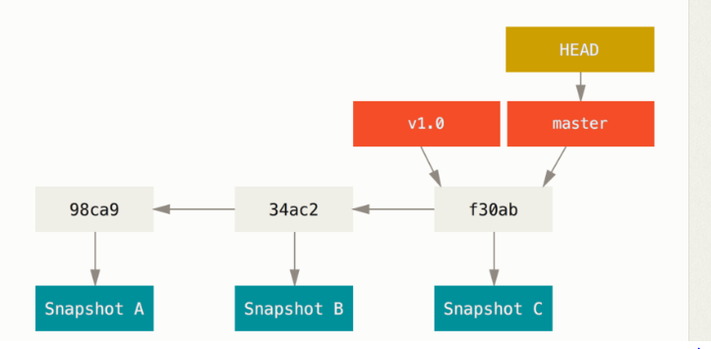
Default branch
A branch in Git is simply a lightweight movable pointer to one of these commits. The default branch name in Git is master. As you start making commits, you’re given a master branch that points to the last commit you made. Every time you commit, the master branch pointer moves forward automatically

Slide 4

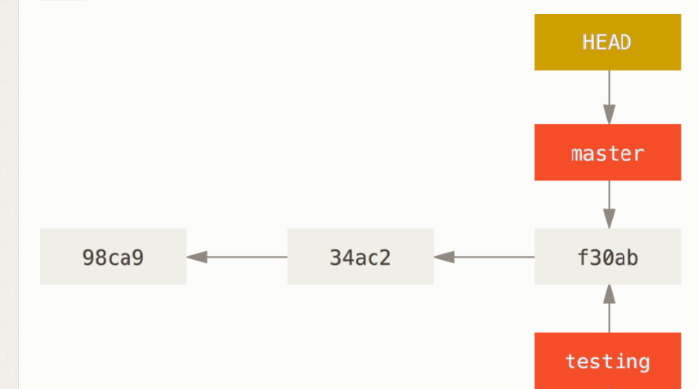
Create new branch

Slide 5
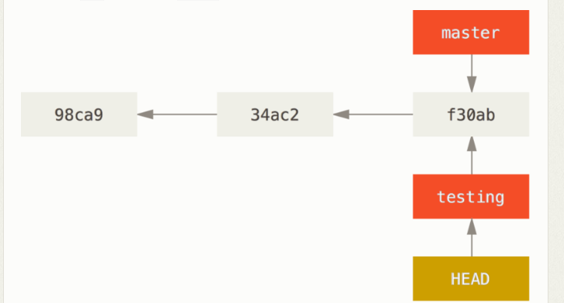
Switching the branch
git checkout testing
git log --oneline --decorate

